Slide 1
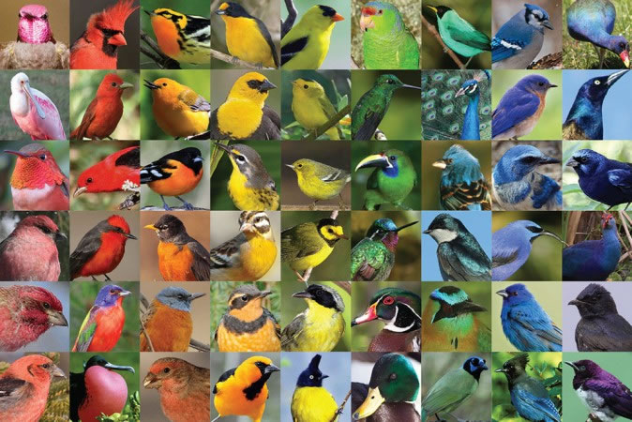
TOPIC : COLOUR PIGMENTATION IN BIRDS
INTRODUCTION :
Biological pigments are also known as simlpy as pigments & biochromes
They are substance produced by living organisms that have a coloufull resulting from selective colourfull absorption.
Biological pigments includes plant pigments and colourfull pigments in birds.

Slide 2
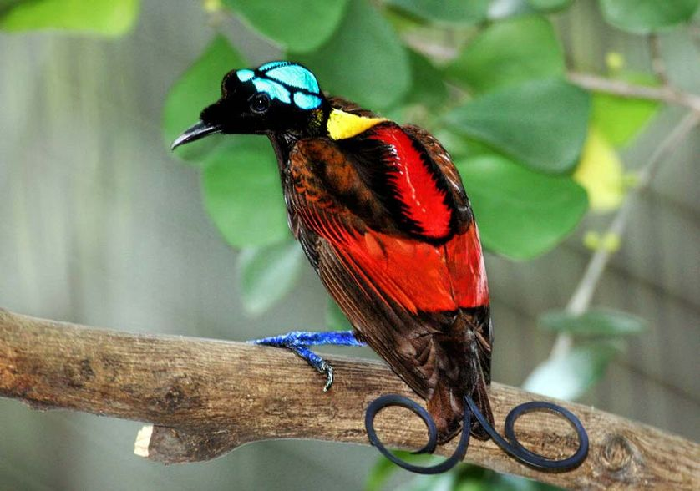
Colorfull feathers
Some of birds are given below which have colorfull feathers.
i: Wilson’s bird-of-paradise, ii: Albatross, iii: Booby.
i: Wilson’s Bird-of-Paradise:-
A fancy tail doesn’t have to be exceptionally long, it can also be exceptionally well styled.
The unusual appearance of the bird, starting with its naked blue head, is made all the more interesting by two violet tail feathers that curl in opposite directions.
The bird was filmed in the wild for the first time as recently in 1996.

Slide 3
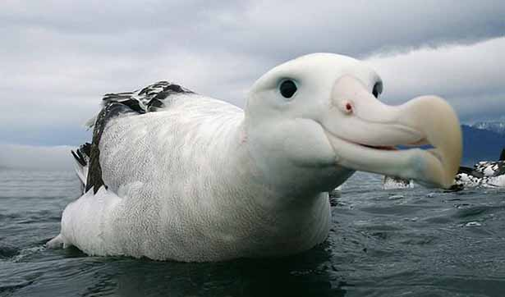
ii: Albatross:-
It is a both rainforest and seabird that depend on fishes for food.
In size it is look like a combination of gull, pelican and parrot.
It is one of the most gorgeous tropical bird you’ll ever see, it has a dark grey shade on the face and head side and light grey feathers with white spots at the bottom.
They are surprisingly one of those rare birds that live to long age, and still declared endangered.

Slide 4
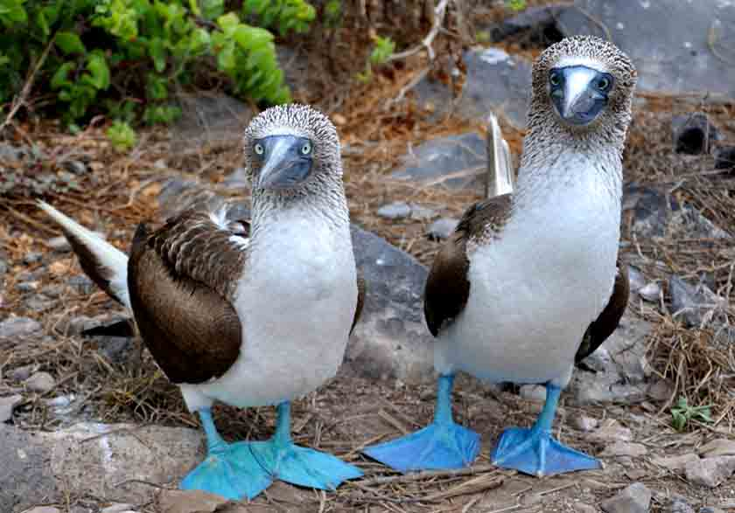
iii: Booby:-
This is one of those tropical birds that can swim, fly and swoop to hunt for food. It’s a seabirdthat quite a large bird and can be as big as spelicans.
The bird has a long beak that helps it catch fishes easily, with a smooth plumage, wide and long wings, and duck foot pigmentation.
Its blue color footb also indicate the current health condition of a booby.

Slide 5
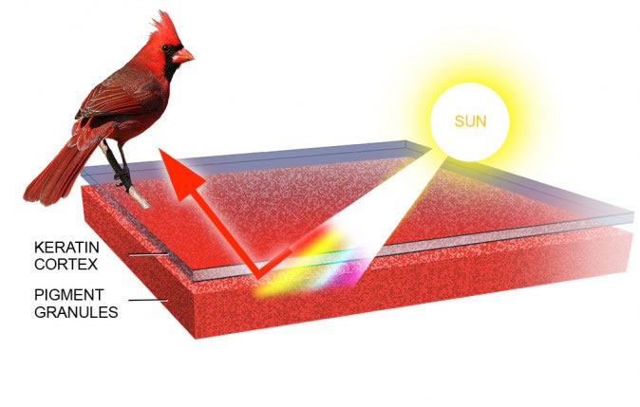
HOW BIRD’S FEATHERS ARE COLOURFUL??
Amazing diversity of colors and patterns exhibited by more than 9000 bird species found in the world.
The colours in the feathers of birds are formed in two different ways :
i: pigments ii: light refraction.
PIGMENTATION
Pigments are colored substance that can be found in both plants and birds.
The coloration created by pigments is independent of the structure of the feathers.
Pigment colorization in birds comes from 3 different groups: carotenoids, melanins, porphyrines.

Slide 6
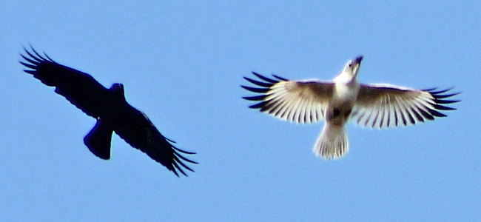
Color abnormalities
When pigments are present (or absent) at unusual levels the appearance of abird can change dramatically.
Color abnormalities , while not common, do occur on a regular basis.
Few are the examples of birds that commonly show abberant white patches:
canada goose, American crow, Black-capped, Chickadee, Dark-eyed junco,Common grackle and House sparrow.

Slide 7
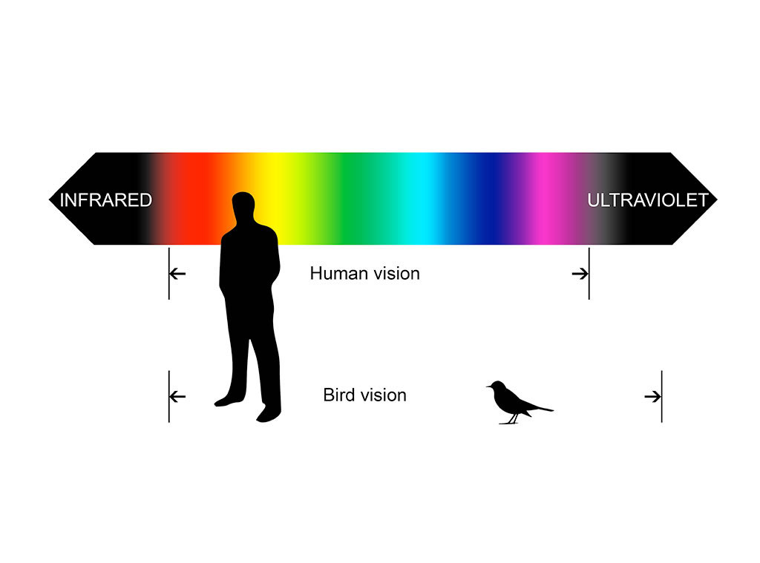
Ultraviolet feathers
The feather structure of many species also reflect light in the ultraviolet range, because many birds can discriminate a greater variety of colors than humans, including ultaviolet wavelengths, they can appear quite different to each other.

Slide 8

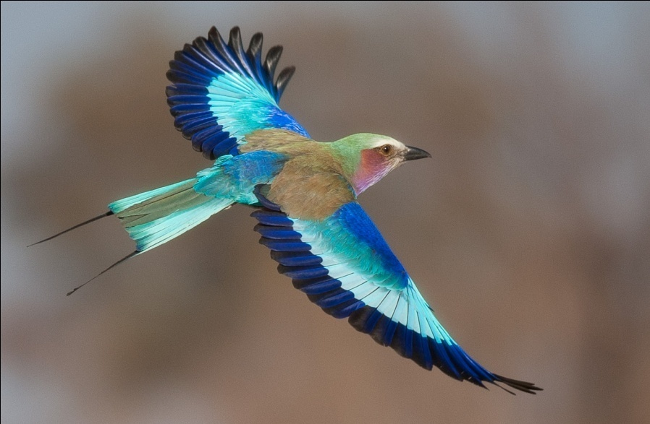
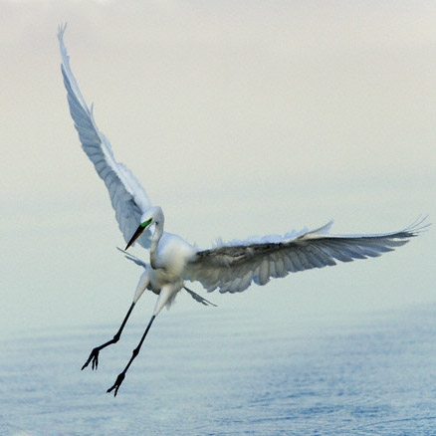
Flight & Flightless Birds
Introduction:-
There are two types of birds.
i: flying birds ii: non flying birds.
Flying Birds:-
Flying birds have warm bodies.
The body temperature of flying birds is generally higher than that of humans, so they seem warm to the touch.
They live in woodlands, open areas, cities, lakes, swamps even the open oceans.
They lay their eggs and raise their youngs in holes in the ground, in nest of varying complexity in vegetation or on the ground, in holes in trees, in human constructed nest boxes, and in or on various parts of buildings.

Slide 9
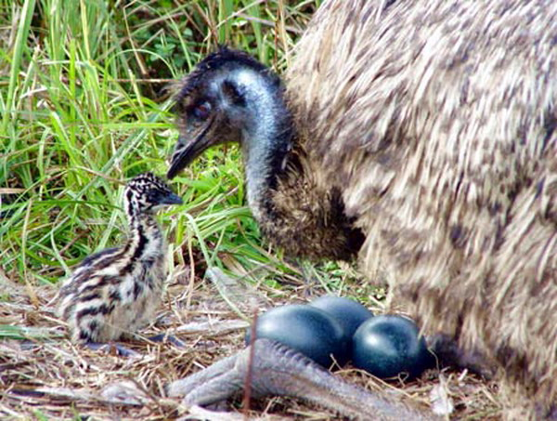
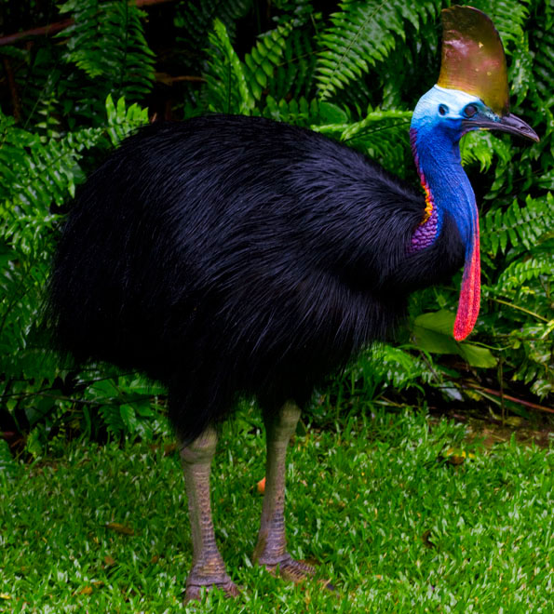
Non-Flying Birds:-
Flightless birds are birds that have evovled the inability to fly.
Threre are over 40 extant species including the well known ratites, ostrich, emo, cassowary, rhea and kiwi etc.
The smallest flightless bird is the inaccessible Island rail (length 12.5 cm, weight 34.7 g), the largest ( both heaviest and tallest ) flighless bird, which is also the largest living bird, is the ostrich ( 2.7m , 156 kg), ostriches are farmed for their decorative feathers, meat and their skins, which are used to make leather.
Flightlessness has evolved in many different birds independently, they were also other families of flightless birds, such as the now extent phorusrhacidae, that evolved to be powerfull predators.

Slide 10
Comparison Between Flying & Non-Flying Birds:-
Flying Birds ( carinatae )
Flightless Birds ( ratitae
i:They are usually small in size.
ii:They have well developed wings.
iii: Tail quills are present.
iv: Oil gland is present.
v: well developed flight muscles.
vi: They have cosmopolitan distribution ( found everywhere ).
i: They are usually large in size.
ii: They have poorly developed wings.
iii: Tail quills are absent.
iv: Oil gland is absent.
v: Reduced flight muscle.
vi: They have discontinuous distribution.

Slide 11
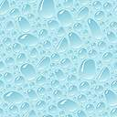
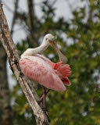
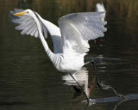
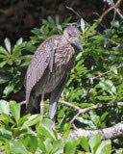
Flying Birds:-
Great Egret.
Roseate spoonbill.
Yellow crowned night heron

Slide 12

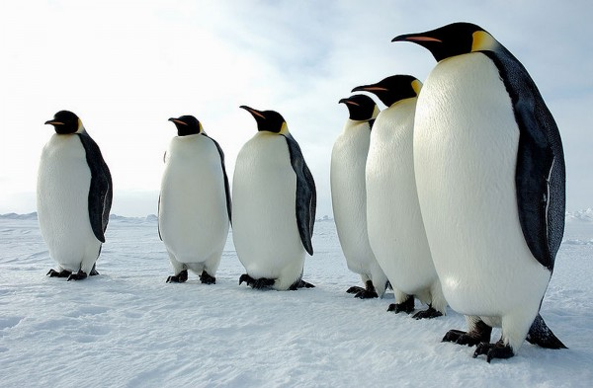
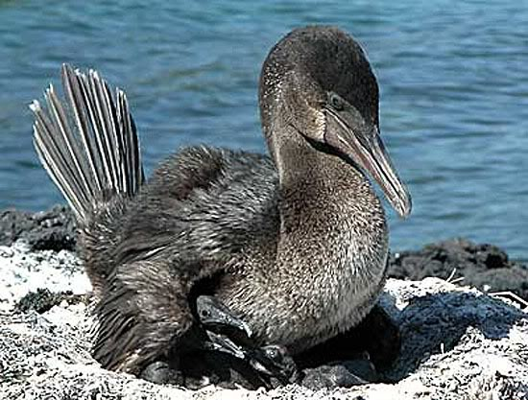
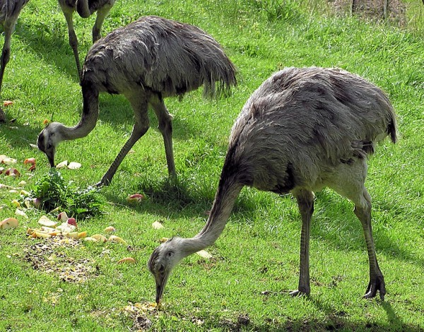
Non-Flying Birds:-
Emperor Penguins.
Flightless cormorant.
Great Rhea.

Slide 13
Male Birds Are more attractive Than Female:-
Males are more colorfull or ornamented than females in most, but not all bird, species.
Sexual selection is responsible for many of the features unique to one sex in a given species. These features can be divided into two categories,
i: Those acting as weapons that allow males to fight for access to females
ii: Other acting as ornaments that attract the attention of females, such as long tails on birds.
3.

